Slide 1
Microsoft Teams – Authentication & Single Sign-on with tabs & bots

Slide 2
Authentication and authorization in Microsoft Teams apps
Microsoft Teams and single sign-on (SSO)
Implementing SSO in Microsoft Teams apps

Slide 3
Microsoft Teams and Single Sign-on (SSO)
Microsoft Teams SSO support added to in 2020
Tabs
Task modules (web experience)
Conversation bots
Reduces how often users are prompted to login to third-party services
Implemented using:
Azure AD application
Azure Bot Framework (for bots)
Client-side code in the app (for tabs & web-based task modules)

Slide 4
Register the Azure AD application

Slide 5
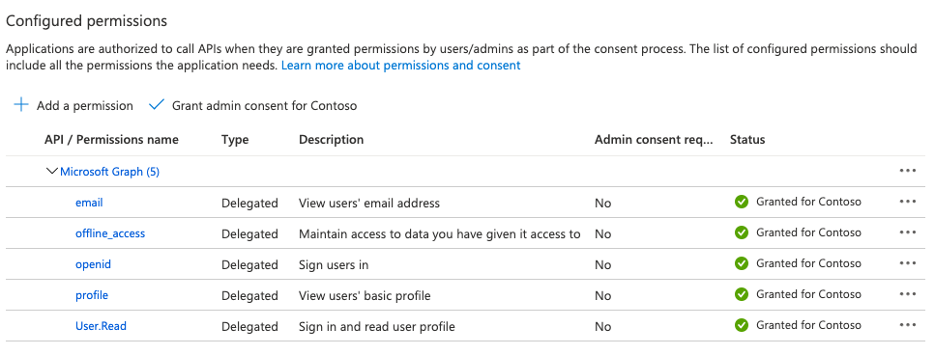
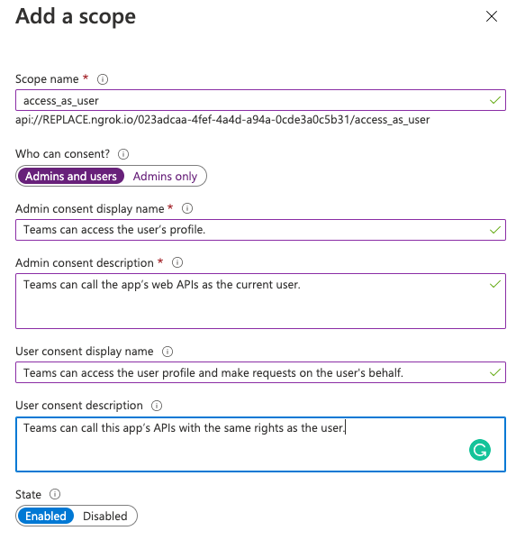
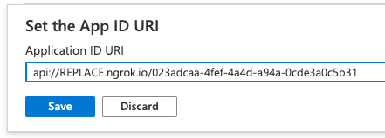

Slide 6
Associate the Microsoft Teams app with the Azure AD application
Link the app to the Azure AD app in the app’s manifest
Defined in the webApplicationInfo object
Id: Azure AD application’s [client] ID
Resource: URI of the add-in as listed in the Azure AD app registration
"webApplicationInfo":
{
"id": "023adcaa-4fef-4a4d-a94a-0cde3a0c5b31",
"resource": "api://app.com/023adcaa-4fef-4a4d-a94a-0cde3a0c5b31"
}

Slide 7
DEMO
Implement single sign-on (SSO) for Microsoft Teams apps

Slide 8
Understand the SSO authentication flow
Configure the Azure AD application for SSO with Microsoft Teams tabs
Implement SSO in Microsoft Teams tabs

Slide 9
Understanding SSO in Microsoft Teams tabs

Slide 10
Microsoft Teams can't prompt for to consent Microsoft Graph permissions
Microsoft Teams apps can use SSO to call Microsoft Graph
Tabs first trigger the Microsoft Teams client to obtain the bootstrap/ID token with getAuthToken()
Bootstrap token exchanged with Azure AD for an access token used to call Microsoft Graph

Slide 11
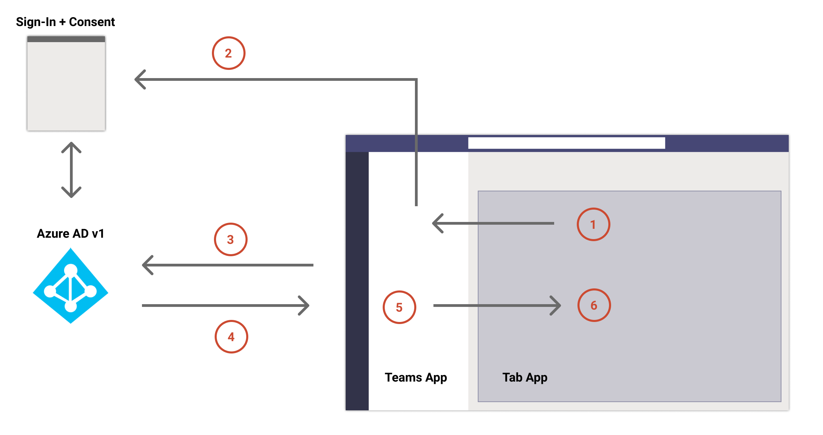
Understanding SSO in Microsoft Teams tabs

Slide 12
Microsoft Teams & Microsoft Graph
Microsoft Teams clients are limited in prompting for user consent to the OpenID profile permission
Microsoft Teams clients can’t prompt user for consent to Microsoft Graph permissions
If user hasn’t consented to Microsoft Graph permission, when the bootstrap token is exchanged for an access token, Azure AD returns the error: AADSTS65001
When your app receives this error code, it should gracefully handle the scenario with a fallback authorization system
Launch popup dialog to prompt the user to consent to Microsoft Graph permissions

Slide 13
Obtain ID token from Microsoft Teams
authentication.getAuthToken({
resources: [process.env.TAB_APP_URI],
silent: false
} as authentication.AuthTokenRequestParameters
).then(token => {
app.notifySuccess();
}).catch(message => {
app.notifyFailure({
reason: app.FailedReason.AuthFailed,
message
});
});
Use the Microsoft Teams JavaScript SDK to obtain token
Microsoft Teams will request an an ID token from Azure AD
The token returned contains claims to identify the currently signed in user
The token can’t be used to authorize Microsoft Graph requests

Slide 14
Exchange the ID token for an access token for Microsoft Teams
Use the ID token obtained by Microsoft Teams to obtain an access token that can be authorized to call Microsoft Graph
Use the OAuth2 on-behalf-of flow to obtain a token to call Microsoft Graph
This exchange must happen in a server-side API, not client-side
HTTP POST https://login.microsoftonline.com/{tenant-id}/oauth2/v2.0/token
CONTENT-TYPE: application/x-www-form-urlencoded
client_id={client_id}, client_secret={client_secret},
grant_type=urn:ietf:params:oauth:grant-type:jwt-bearer,
requested_token_use=on_behalf_of,
assertion={sso_id_token},
scope=profile openid User.Read Mail.Read

Slide 15
DEMO
Single sign-on (SSO) with Microsoft Teams tabs

Slide 16
Understand the SSO authentication flow
Configure the Azure AD application for SSO with bots
Configure the bot's OAuth connection settings

Slide 17
Understanding SSO in Microsoft Teams bots

Slide 18
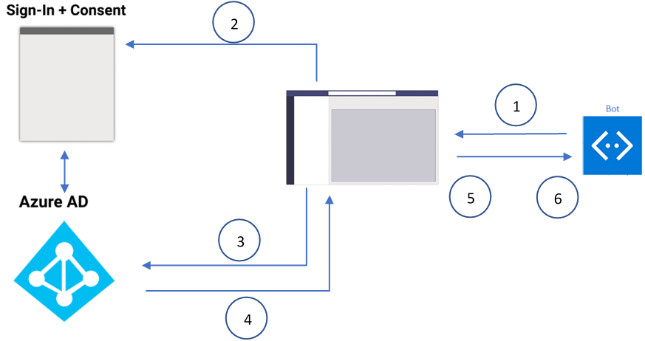
Understanding SSO in bots

Slide 19
Configure the Azure AD app for SSO with bots
Azure AD app requirements match those for an app used in tab SSO, with a few differences
Redirect URI should point to the Bot Framework token endpoint
https://token.botframework.com/.auth/web/redirect
Expose API: Application ID URI should be prefixed with botid-, not a domain where the tab is hosted
api://botid-023adcaa-4fef-4a4d-a94a-0cde3a0c5b31

Slide 20
Azure Bot Framework registration & SSO
Bots registered with the Azure Bot Framework can be used with Microsoft Teams
To support SSO, add an OAuth connection setting in the bot’s properties
Associate the bot OAuth settings with the registered Azure AD app
Set the Token Exchange URL to the Application ID URI
Set Tenant ID to common
Set Scopes to a space-delimited list of permissions the bot needs

Slide 21
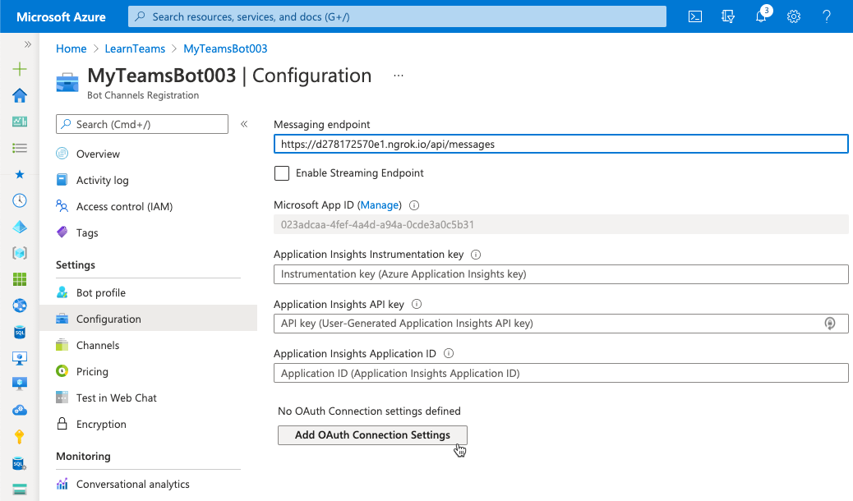
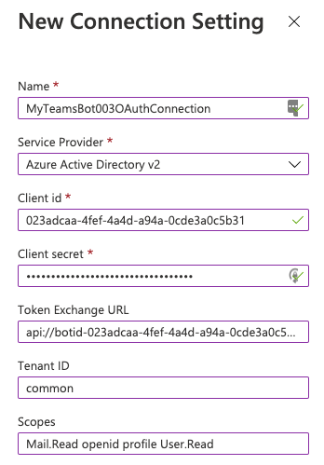
Bot OAuth connection settings

Slide 22
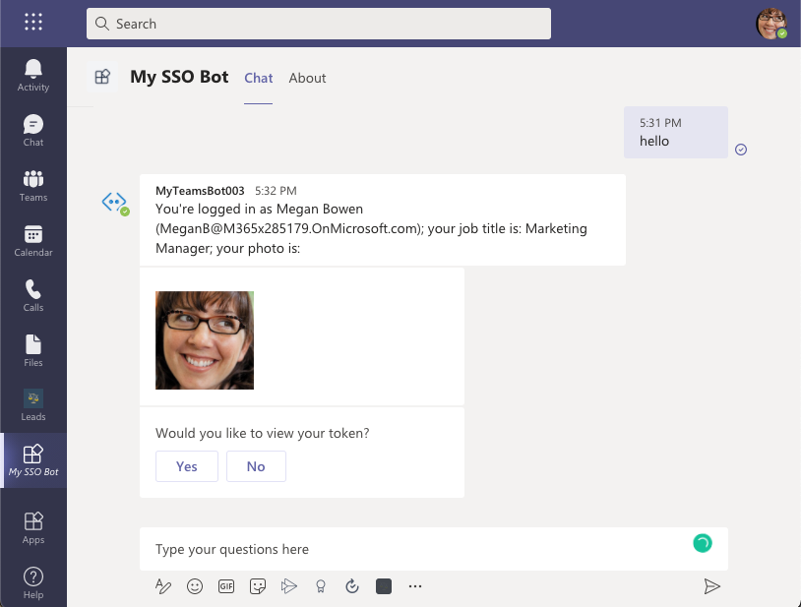
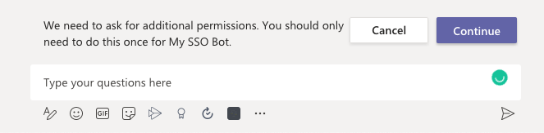
Microsoft Teams SSO bot end user experience
When a user activates the bot the first time, it will prompt for consent

Slide 23
When building bots that require authentication, consider dialogs
Provide state-based model to manage long-running conversation with user
Nature of sequential conversation that depends on authentication makes dialogs well suited for the scenario
Simply the sequential steps of:
Signing in
Interacting with the user, secured resources, and both authorization
Signing out
Learn more:
Bot Framework – Dialogs
https://docs.microsoft.com/composer/concept-dialog
Bot Framework SDK – Dialogs library
https://docs.microsoft.com/azure/bot-service/bot-builder-concept-dialog

Slide 24
Coding an SSO bot for Microsoft Teams
// using the WaterfallDialog approach
constructor() {
this.addDialog(new WaterfallDialog(‘MainDialog’, [
this.promptStep.bind(this),
this.displayMSGraphDataStep.bind(this)
]));
}
// prompt the user to sing in if necessary, otherwise obtain token
async promptStep(stepContext) {
return await stepContext.beginDialog(’OAuthPrompt’);
}

Slide 25
Coding an SSO bot for Microsoft Teams
// import { Client } from “@microsoft/microsoft-graph-client”;
async displayMSGraphDataStep(stepContext) {
const tokenResponse = stepContext.result;
if (!tokenResponse || !tokenResponse.token) {
await stepContext.context.sendActivity('Login unsuccessful - try again.');
} else {
const msGraphClient = Client.init({ authProvider: (cb) => { cb(null, this.token); } });
// get user's basic profile information
const me = await msGraphClient.api(“me”).get();
// respond to Microsoft Teams with an activity message
await stepContext.context.sendActivity(
`You're ${me.displayName} (${me.userPrincipalName})`);
}
return await stepContext.endDialog();
}

Slide 26
DEMO
Single sign-on (SSO) with Microsoft Teams bots

